Slide 1
PROFESSIONAL ETHICS
LECTURE # 2

Slide 2


WHAT IS IT?

Slide 3
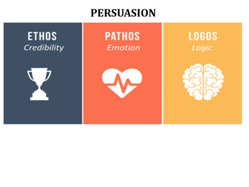
Ethics
The Greek term "ethos," implies character or conduct.
It is the root of the English word "ethics."

Slide 4
Ethics
Ethics refers to the principles of moral behavior and the conduct of individuals or groups.
What is morally right or wrong, good or bad.
It involves principles and values that guide human behavior.

Slide 5
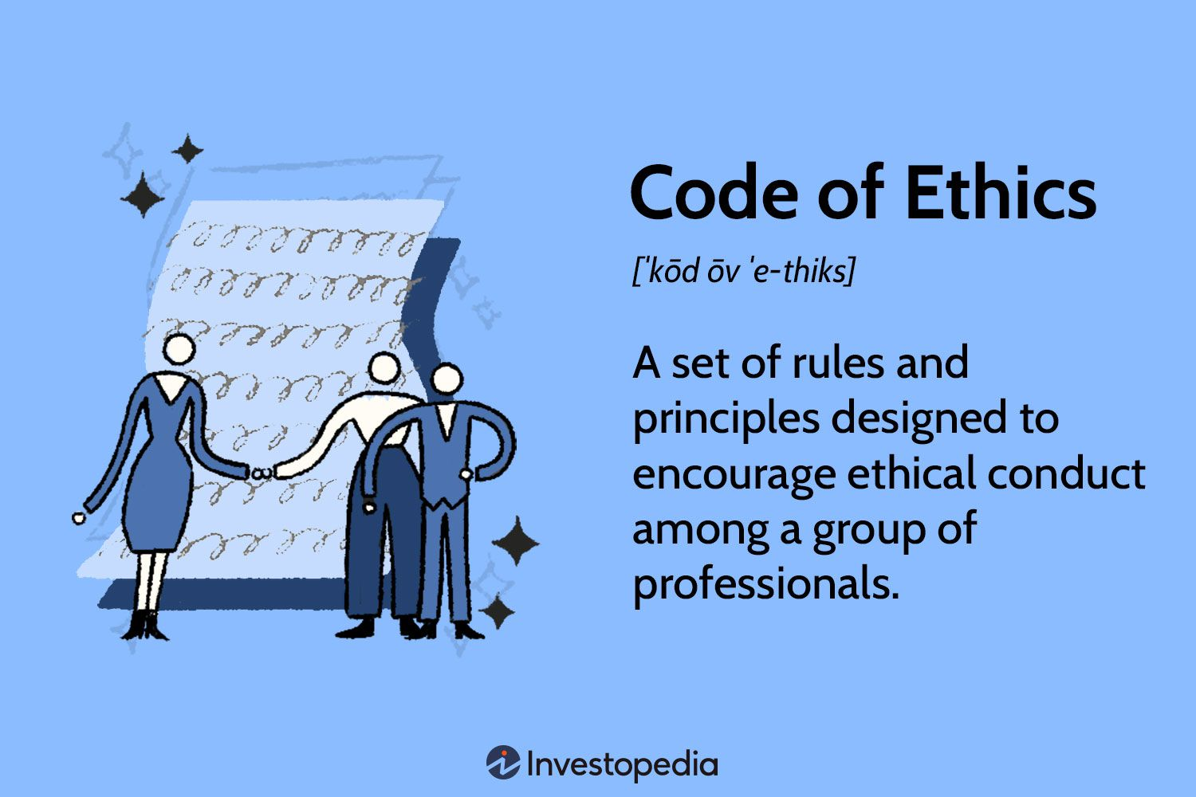
Definition

Slide 6
Importance of Ethics
Guiding Behavior
Interpersonal Relationships
Promoting Accountability
Organizational Integrity
Creating a Fair Society
Facilitating Decision-Making
Corporate Social Responsibility (CSR)
Legal Compliance

Slide 7
Corporate Social Responsibility
Corporate Social Responsibility (CSR) refers to the ethical and voluntary commitment of businesses and organizations to contribute to the well-being of society and the environment beyond their core economic functions.
The goal is to go beyond profit generation and actively engage in activities that benefit society, communities, and the environment.

Slide 8


Examples – Google office

Slide 9
Examples
Human Rights Advocacy:
Example: The Body Shop, a cosmetics and skincare company, has a history of advocating for human rights. The company is known for its commitment to fair trade, cruelty-free products, and campaigns against animal testing and human rights abuses
Employee Welfare and Well-being:
Example: Google offers various employee benefits and initiatives to enhance well-being. These include comprehensive healthcare coverage, on-site wellness programs, and mental health support. Google's emphasis on employee satisfaction contributes to a positive workplace culture.

Slide 10

THINK
"How do you believe Google's focus on employee satisfaction and well-being impacts the overall ethical culture within the company?"

Slide 11
Google!
Google's approach to employee welfare and well-being aligns with various ethical principles, including respect for individuals, fairness, promotion of human flourishing, and ethical leadership.
By prioritizing the holistic well-being of its employees, Google contributes to creating an ethical workplace culture that values and supports its workforce.

Slide 12

Can we always do the right thing ?

Slide 13
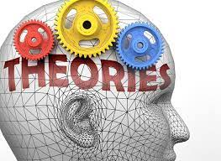
Ethical Theories
Key Ethical Theories:
Utilitarianism
Deontology
Virtue Ethic

Slide 14
Utilitarianism
Utilitarianism is an ethical theory that suggests the best action is the one that maximizes overall happiness or pleasure while minimizing suffering.
When making decisions, you should choose the option that leads to the greatest amount of happiness for the greatest number of people.
Focus on Consequences: Utilitarianism looks at the outcomes or consequences of actions rather than the inherent nature of the actions themselves.

Slide 15
Utilitarianism
Often used in ethical decision-making, public policy, and issues related to resource allocation.
It emphasizes a quantitative approach to assessing the overall well-being resulting from different actions.
“The greatest good for the greatest number”
Rules can be broken if it has positive consequence like stealing to save a dying wife
Consequence is always the King

Slide 16
Deontology
Deontology is a non-consequentialist ethical theory associated with philosophers like Immanuel Kant.
Do the RIGHT thing — even if it hurts
Lying to save a life is ok acc to utilitarianism but not allowed in deontology
It asserts that the morality of an action is determined by adherence to moral rules or principles, irrespective of the consequences.
Emphasizes the importance of duty, and actions are considered morally right if they conform to universalizable principles.
Emphasis on the intention behind an action rather than its outcomes.

Slide 17
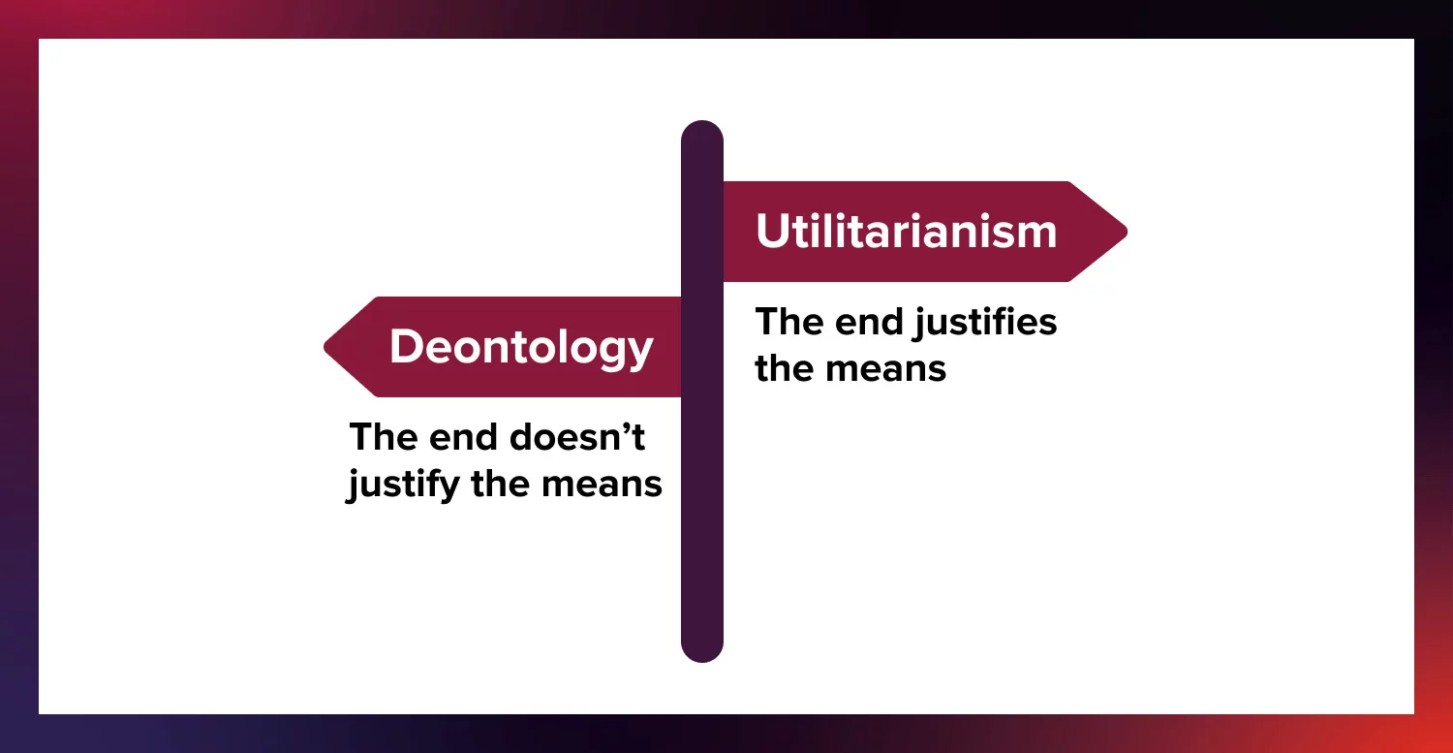
A Battle of Ethics

Slide 18
Virtue Ethic: Who You ARE Matters Most
Virtue ethics, associated with philosophers like Aristotle, focuses on the development of virtuous character traits.
It emphasizes the importance of being a good person rather than strictly following rules or achieving specific outcome.
such as honesty, courage, compassion, and integrity.

Slide 19
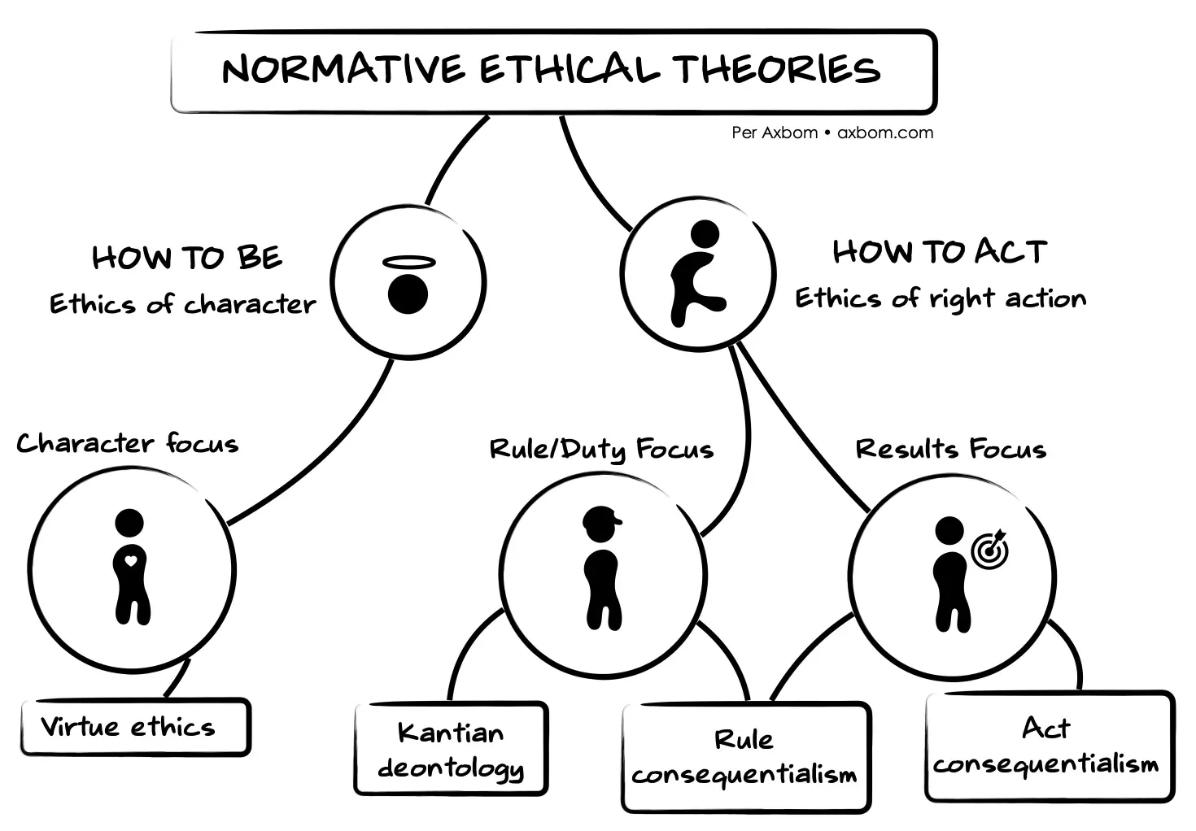
Normative ethical theories

Slide 20
Think !
Which theory to follow?
Notes:
The choice of which ethical theory to follow in daily life often depends on personal values, beliefs, and the specific circumstances of each situation.

Slide 21
Ethical Dilemmas
Situation: A manufacturing company is deciding whether to continue using a production process that generates significant environmental pollution but is cost-effective, or to invest in a cleaner and more environmentally friendly production method, which would be more expensive.
Notes:
Apply the 3 theories

